Slide 1
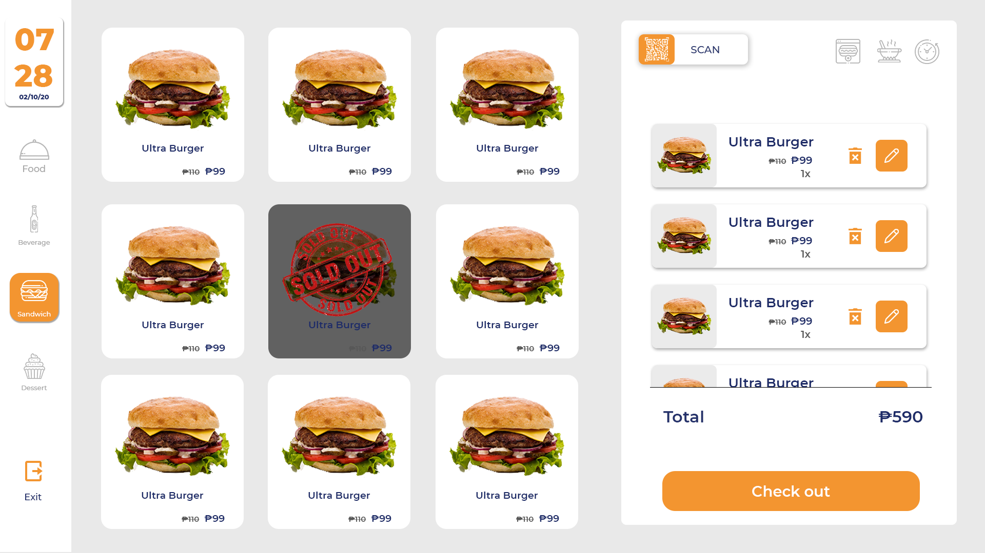
GUTOM
Food Ordering System
Gerongco
Lluvido
Caja
Angayan
Aranas
Lacerna

Slide 2
Gutom - Products
Main – kwek2x/fries/siomai/siopao/Kikiam/Isaw/fishball
Desert- Shake(mango,durian,avocado)/halo2x/gulaman
Drinks- coke/sprite/royal/mineral water

Slide 3
Admin
Can add employee
Can delete employee
Can update employee
Can view employee
Calculate sales-day/month/year
Print sales report
Can log-in
Can register

Slide 4
User
Can select items/products
Calculate total order
Print receipt
Can log-in
Can register

Slide 5
User
Customer
Order/s
User
Take Order
Process Order/s
Give receipt
User
Pay Order/s
Customer
Calculate Total Order/s
From the representation, in the user scenario Customer will state the order/s to the user. Then the user will take the order and process it from what product will be purchase and then calculate the total amount of order and bring it back to the customer as the customer’s pay a certain amount the user will print the receipt.

Slide 6
Admin
Employee Management
Admin
Product Management
Sales Report
The admin will check the sales for a day, month, year and can create and print sales report. Admin can also manage employees (crud system will take place). Admin can manage product status.

